Slide 1
Case Studies
4/26/2013
Ryan, Jackie, Robert, Mike, Larisa, Bryan

Slide 2
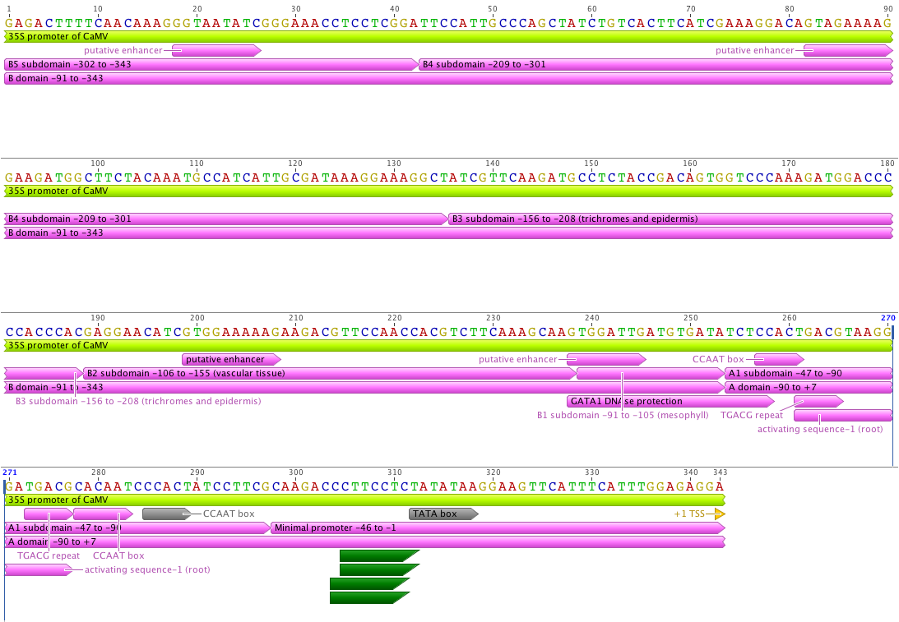
JN654719 - 35S promoter of CaMV 343 bp (modified).xml

Slide 3
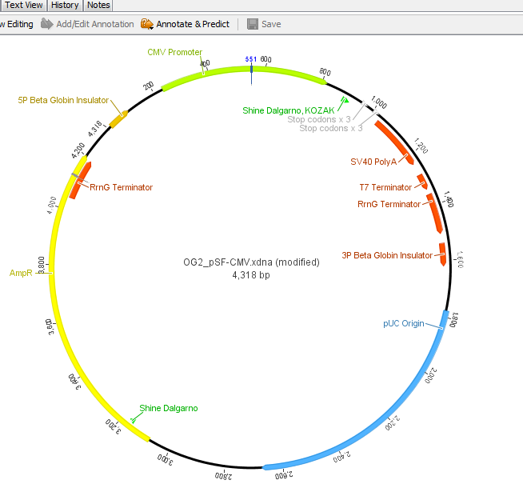
OG2_pSF-CMV.xdna (modified)

Slide 4
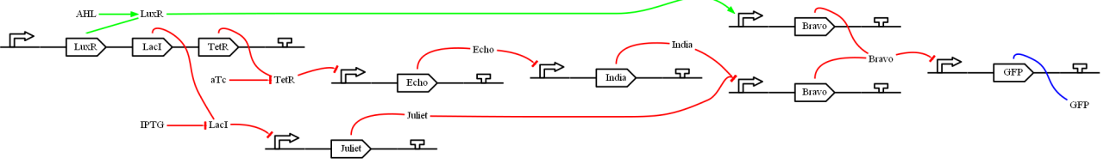
green (not (or (AHL) (and (aTc) (not (IPTG))))))

